Slide 1
PrEP and U=U in Community
Robert M Grant, M.D., M.P.H.
University of California,
San Francisco
July 26, 2018

Slide 2
Unmet challenges on the road to ending HIV/AIDS
Reduce stigma
More inclusion and diversity
Increase HIV testing
Increase uptake of PrEP and ART
Increase access to services
Full funding
Social theory of practice could identify how these problems arise, and how we can shift our practices for desired outcomes.
Morten Skovdal. Association of Social Sciences and Humanities in HIV (ASSHH), Amsterdam, 2018;
Blue et al, Critical Public Health, 2016 26(1): 36–50;
Cecily Jane Maller, Sociol Health Illn. 2015 Jan;37(1):52-66.

Slide 3
Learning from Prior Movements In the Struggle with HIV/AIDS
Condom Use in Early 1980s
“Love Carefully” Uganda early 1990s
Seroadaptive practices in the late 1990s
PrEP among gay men after 2013
U=U after 2016
Common Characteristics
Technology is involved, but is not sufficient
Grass roots initiatives then mobilization
Person to person connections
Affirms sexual and social goals
Continual reinvention required

Slide 4
PrEP and U=U practices share several social manifestations
Decrease fear of HIV and PLHIV
Safer more pleasurable sex
Inspire vehement controversy
Start with an HIV test
Involve taking and trusting ART
While professional providers sometimes see PrEP and treatment has different or even competing projects, communities embrace the communalities.

Slide 5
How PrEP and U=U Disrupt Stigma: Bridging The Serological Divide
Seroadaptive behaviors.
Sexual practices based on serostatus of partners.
Serosorting is the extreme, in which sexual partners with a different serostatus are excluded.
Arose in the 1990s among gay men, and also found in some African heterosexual groups.
Ignorance, fear, and stigma foment in the divide.
PrEP use and U=U enable sexual and social bridges across the serological divide; these bridges build trust and community.
Pillow talk is a powerful communication practice.
New divides are appearing based on ART and PrEP use.
These new divides will reinforce stigmas arising from unequal access to income, health care, and information.
McConnell JJ et al. Sexual Seroadaptation: Lessons for Prevention and Sex Research from a Cohort of HIV-Positive Men Who Have Sex with Men. PLoS ONE 5(1): e8831.

Slide 6
Stigma “An Affliction of Normal People and Normal Brains”
Starts with a threat to the group.
Othering: “They could hurt us.”
Othering breaks down conversation.
“The goal in stigma management is to move from these categorical processes to person-to-person relatedness…”
Personal interaction.
Eye to eye conversation.
Sharing vulnerabilities.
Threats to the Group Leading to Stigma
Peril Stigma, Moral Stigma, Courtesy Stigma, Empathy Fatigue
Interventions to Counter Stigma
“The goal in stigma management is to move from these
C
tegorical processes to person-to-person relatedness,
which is organized out of the mirror neuron system and
medial prefrontal systems for mentalization and empathy.”
Ubuntu
“I am because we are”
(translation from Xhosa)
Griffith and Korht Acad. Psychiatry (2016) 40:339–347; Smith Acad. Psychiatry (2016) 40:721–722.

Slide 7
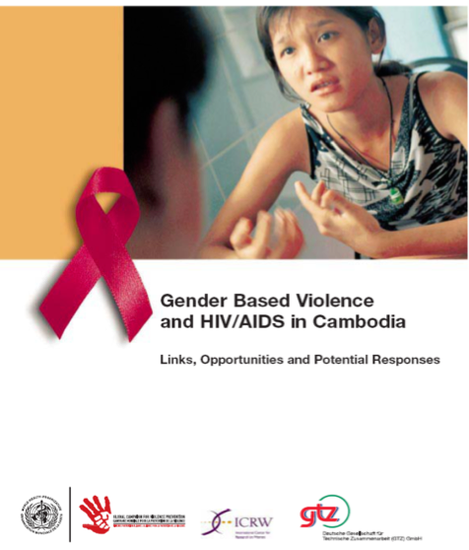
Most Powerful Stigma Intervention:
Listen and Speak
To Each Other

Slide 8
Underutilized HIV Stigma Interventions
Say that U=U to decrease fear of…
PLHIV.
Offer PrEP to decrease fear of …
PLHIV, antiretroviral medications, HIV testing.
Eschew othering language…
The McCarthy era phrase “Risk to the State” was the first time that “risk” referred to people, not situations.
“Risk groups” is later adopted by the HIV/AIDS field.
Temporal variation in sexual practices is enormous: “Identification of high risk people is less helpful than identification of high-risk moments, and the situations that cause them, such as leaving home, becoming an adult, coming out as a man who has sex with men, immigrating to a new city, ending a relationship, and others.”
Grant and Glidden. HIV Moments and PrEP. Lancet 2016;386:1507-8

Slide 9
A New Sexual Health Lexicon
Stigmatizing Words
Them
Their needs
High risk people
Risk behavior
Targeting them
Discordant couple
Adherence
Inclusive Words
Us
Our desires
Popular, affectionate people
Pleasurable sex
Mobilizing us
Couples whose Love > HIV
Use

Slide 10
A Forgotten Lesson from The Original Risk Compensation Theory: Increased fear has only transient effects on driving behavior; Rather, belief in future value fosters durable change.
Future Value | Some Hopes for PrEP and U=U | Some Threats from PrEP and U=U
Future time orientation | A future free from HIV and AIDS. | No scale up while waiting for the next device.
Future Planning | Fosters planning for sex and health. | PrEP and U=U replace sex and health as goals.
Present focus | Increased personal control over risk. | Control externalized to medical authority.
A desirable present | Feeling safe and sexual pleasure. | Viral load and PrEP use divides and stigmatizes along lines of social injustice.
T Björgvinsson and GJS Wilde Safety Science 1996;22(1-3):27-33; Grant NHPC Atlanta 2015.

Slide 11
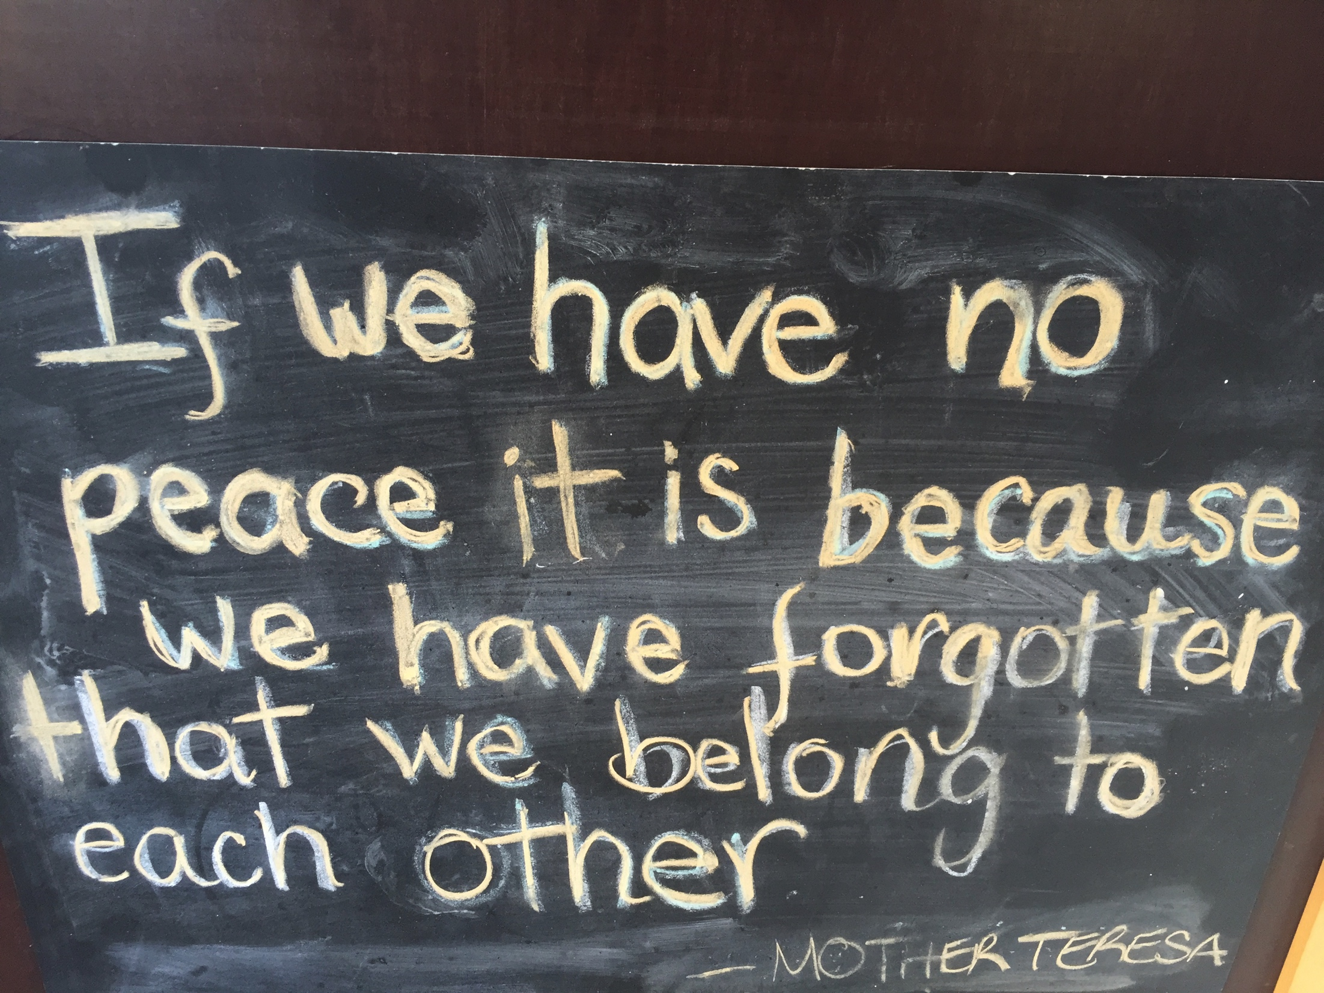

Slide 12
Ubuntu I am because we are (translation from Xhosa)

Slide 13
What do we do now about stigma?
Celebrate U=U and offer PrEP.
Be curious about these as evolving social practices which we enact and shape.
Drive the change we desire in these practices.
Practice inclusion by using inclusive words.
Listen and speak with someone who frightens us.

